Slide 1



R Open Class

Slide 2
Índice
NOVA IMS ALUMNI
About the Instructor
Next steps to Learn R

Slide 3

NOVA IMS ALUMNI
We’re a community of former students of NOVA IMS doing events and promoting networking, mentoring and knowledge sharing.
Follow us (or join as an ambassador) on:
https://www.linkedin.com/company/alumninovaims/
https://www.instagram.com/nova_ims_alumni/
Join our Slack where we share articles, job posts and other stuff! https://shorturl.at/mCO45

Slide 4
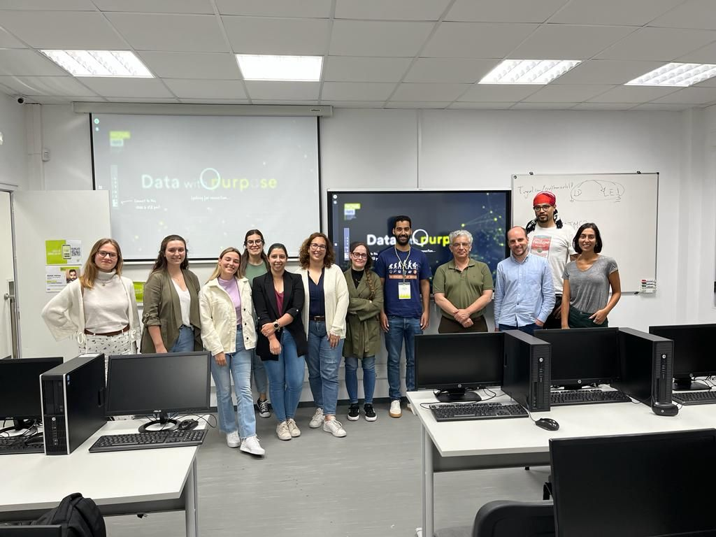
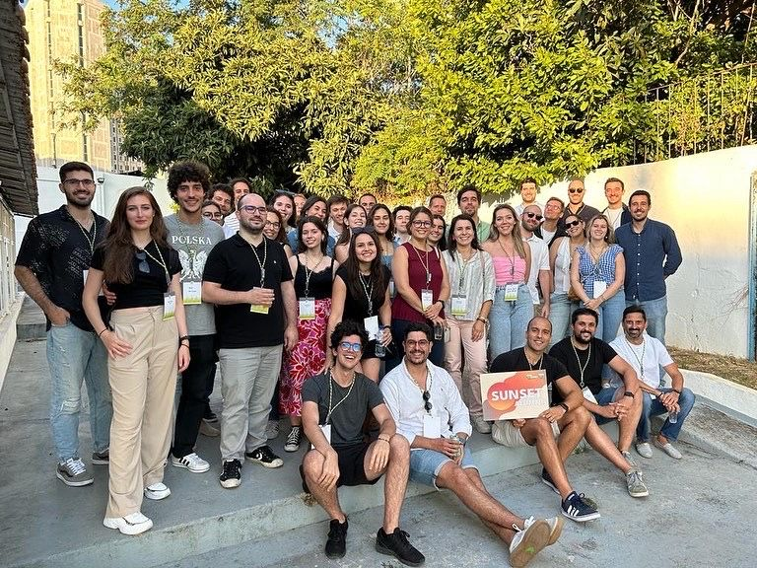
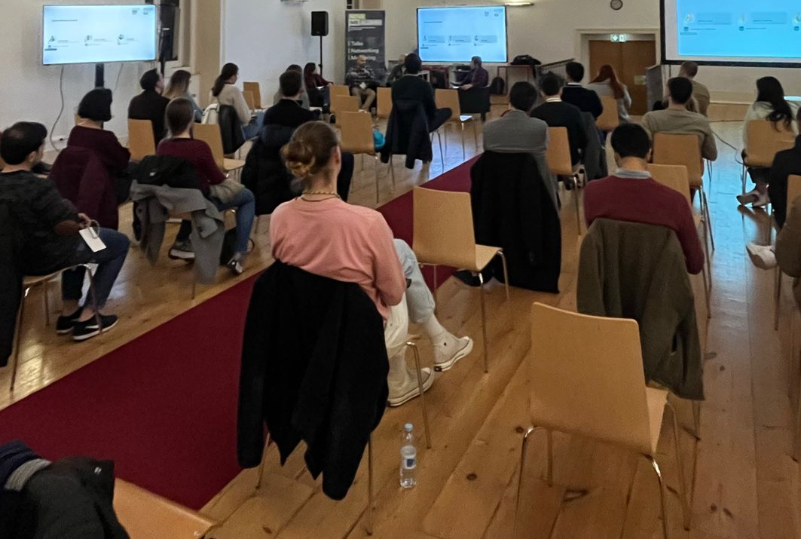
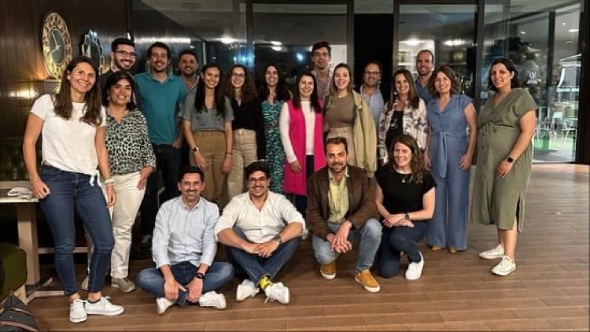
NOVA IMS ALUMNI

Slide 5
About the Instructor

Slide 6
T
Ivo Bernardo
DareData Engineering’s Professional Meeting Attender (corporately called Partner) (https://www.linkedin.com/company/daredata-engineering/)
ALUMNI NOVA IMS Ship Captain (corporately called President)
Instructor @ Udemy
Teaching Assistant @ NOVA IMS (my dream job!)
LinkedIn: https://www.linkedin.com/in/ivobernardo/
Udemy Profile: https://www.udemy.com/user/ivo-bernardo/
Medium Profile: https://ivopbernardo.medium.com/

Slide 7
Learning more about R

Slide 8
Some Links to Help You
Free Udemy Courses (https://www.udemy.com/course/r-for-absolute-beginners/?couponCode=ALUMNINOVAIMS) and (https://www.udemy.com/course/r-for-data-science-first-step-data-scientist/?couponCode=ALUMNINOVAIMS)
Open Repo with some materials – feel free to star, fork, etc. (https://github.com/ivopbernardo/r-programming-absolute-beginners)
My R Programming Book (the only thing I can’t offer for free due to printing costs / commissions, but this is a replication of the other materials that I have above):
Amazon: https://shorturl.at/BNW26
Gumroad (PDF Format): https://shorturl.at/bixES

Slide 9

Thank you!
Contacto: alumni@novaims.unl.pt

